Slide 1
Predictions on Topics of UN Debates at UN Assembly New York with Topic Modelling
Charita Ramnathsing
April 29th, 2020

Slide 2
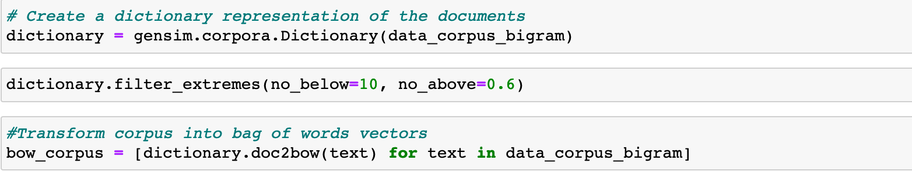
Build Dictionary

Slide 3
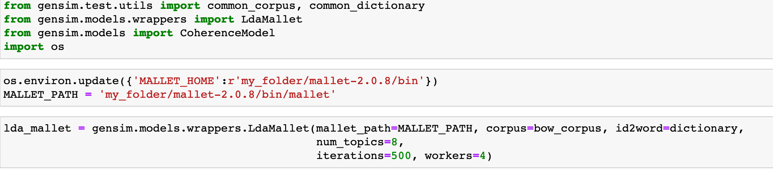
Initialize and run LDA Mallet

Slide 4
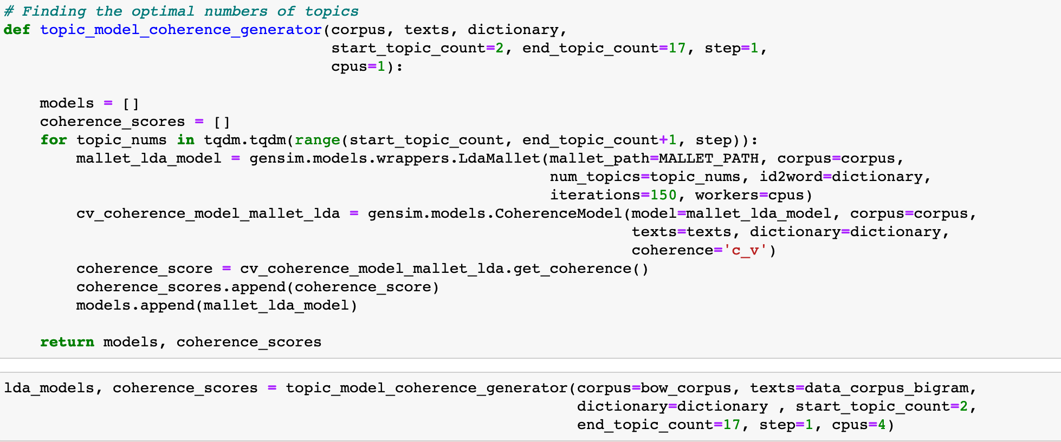
Topic Modelling with ’topic_nums’ topics

Slide 5
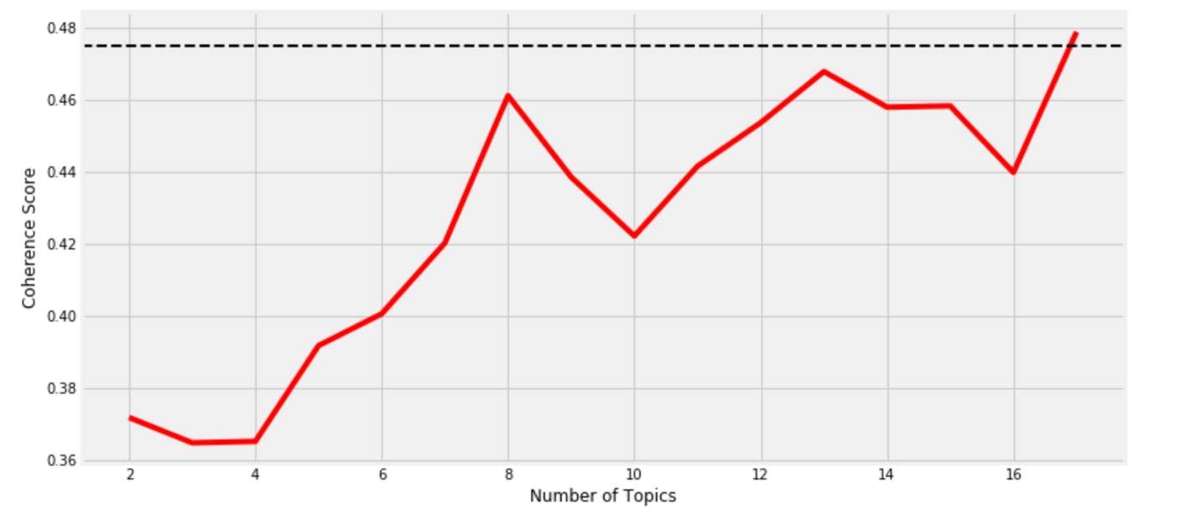
Chosen number of Topics in the Model

Slide 6
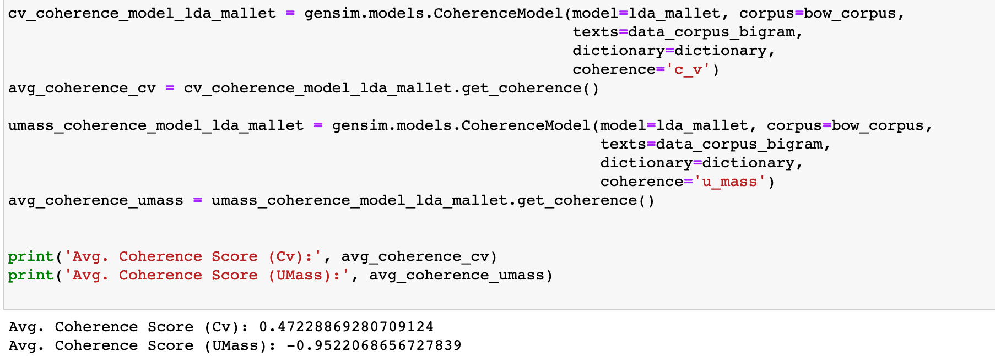
How did the model perform?

Slide 7
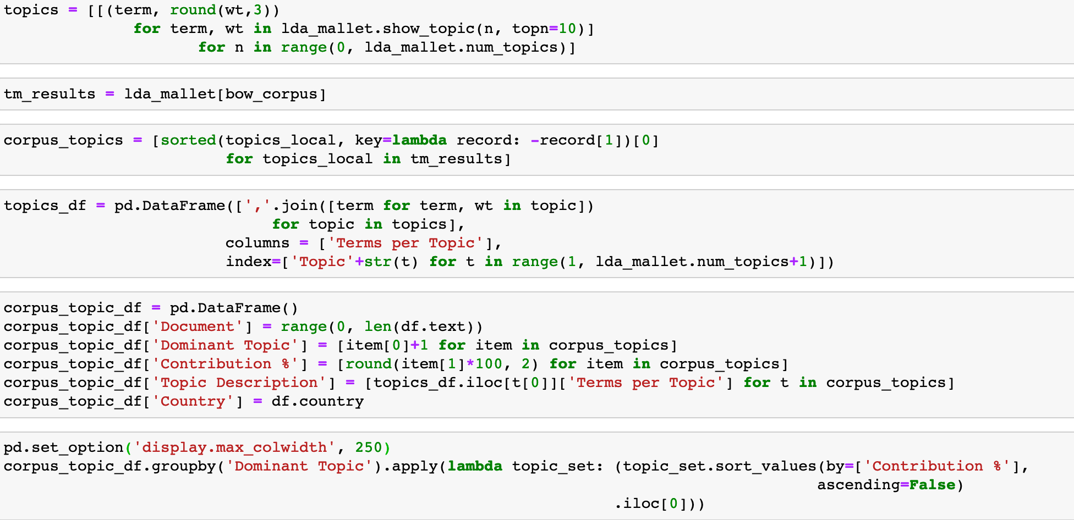
Feature Engineering after Modelling

Slide 8
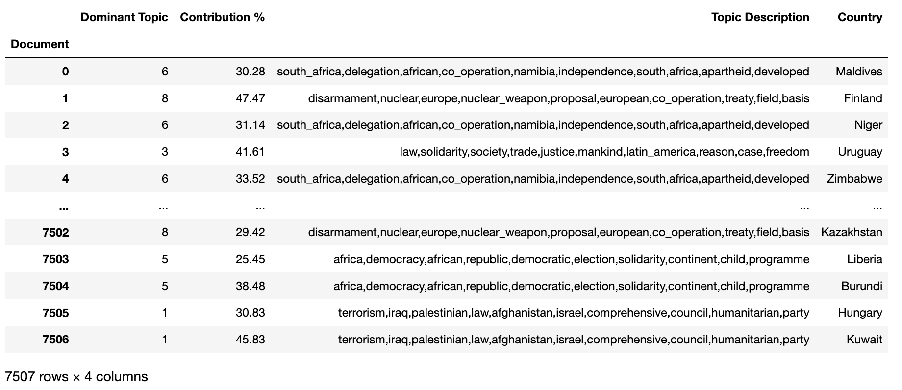
Prediction of Topic After modelling

Slide 9
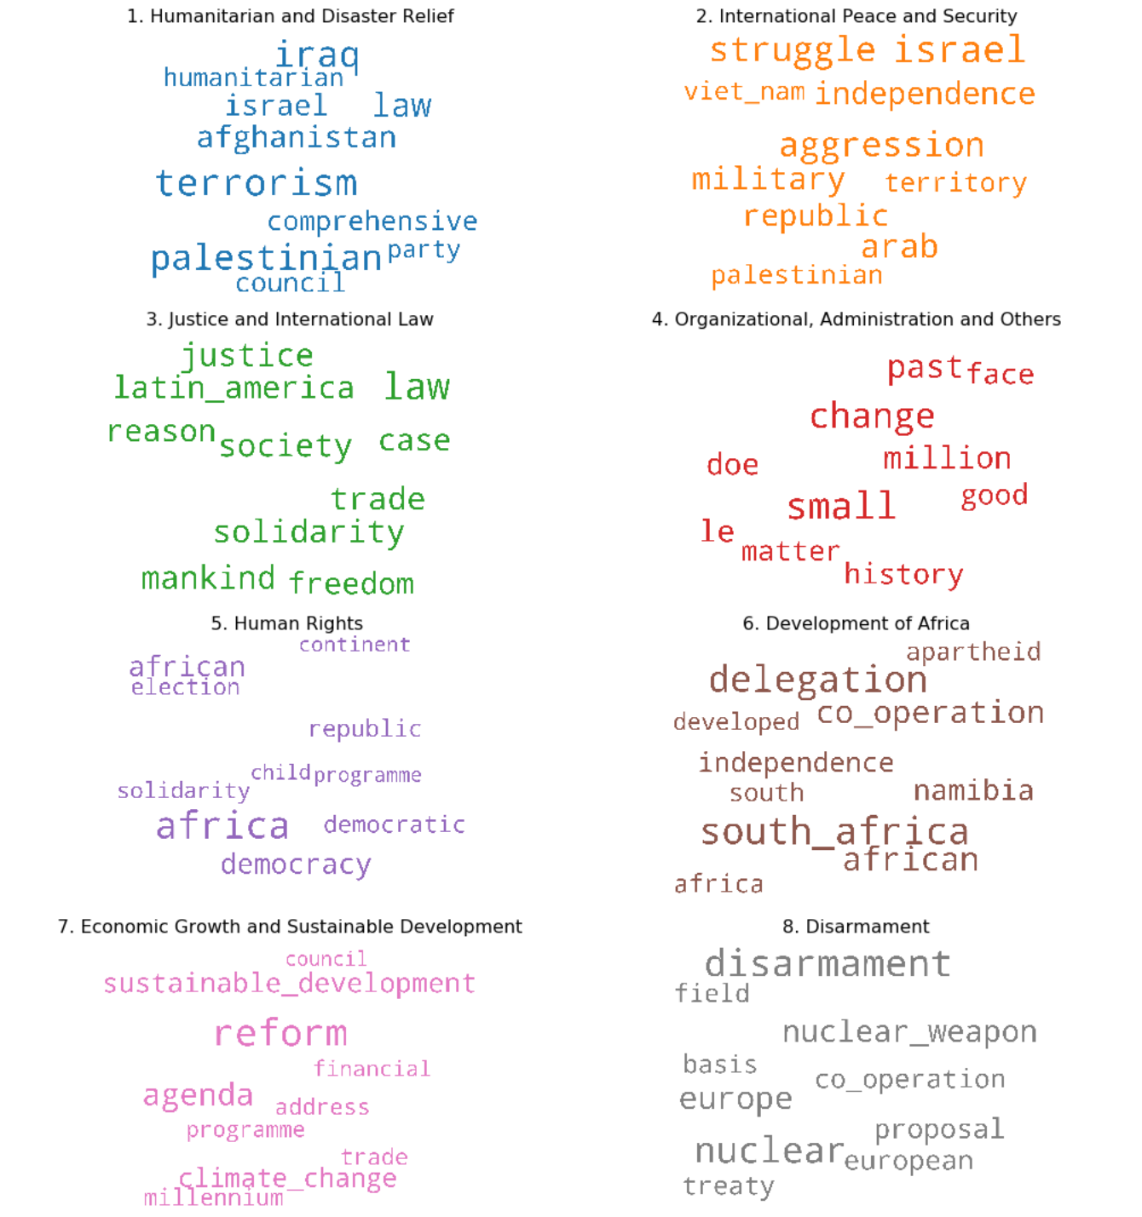
Bag of Words per Topic

Slide 10
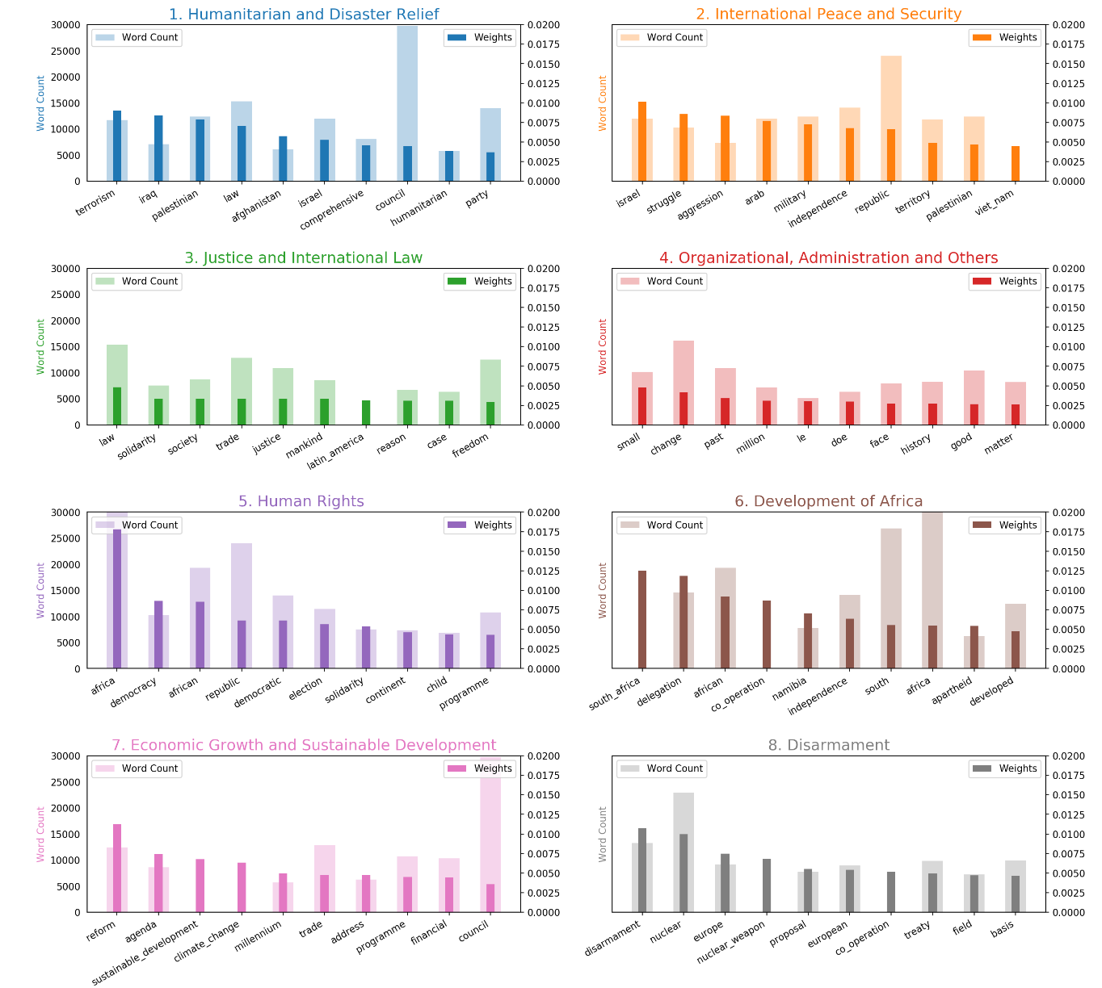
Word use per Topic

